Slide 1
MSP x Delphi Capstone Kick-off
24 February 2022
Anirban Chowdhury, April Wang, Bhoomika Moorjani, Manna Zhao, Rosa Jin

Slide 2
The Team
Our Understanding
Our Approach
Next steps
Contacts
Notes:
•Our Methodology/Approach – What we’re planning
•Next Steps – What we know we need to ask, what we need to do
•Contacts – Who’s doing what?

Slide 3

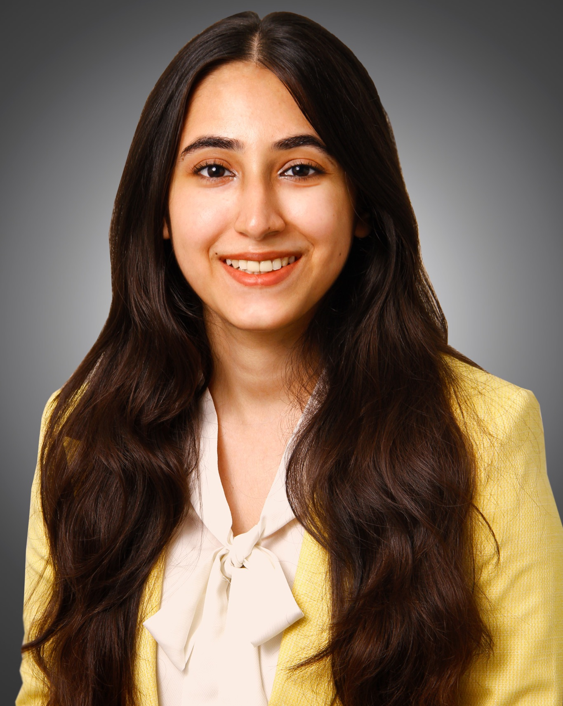
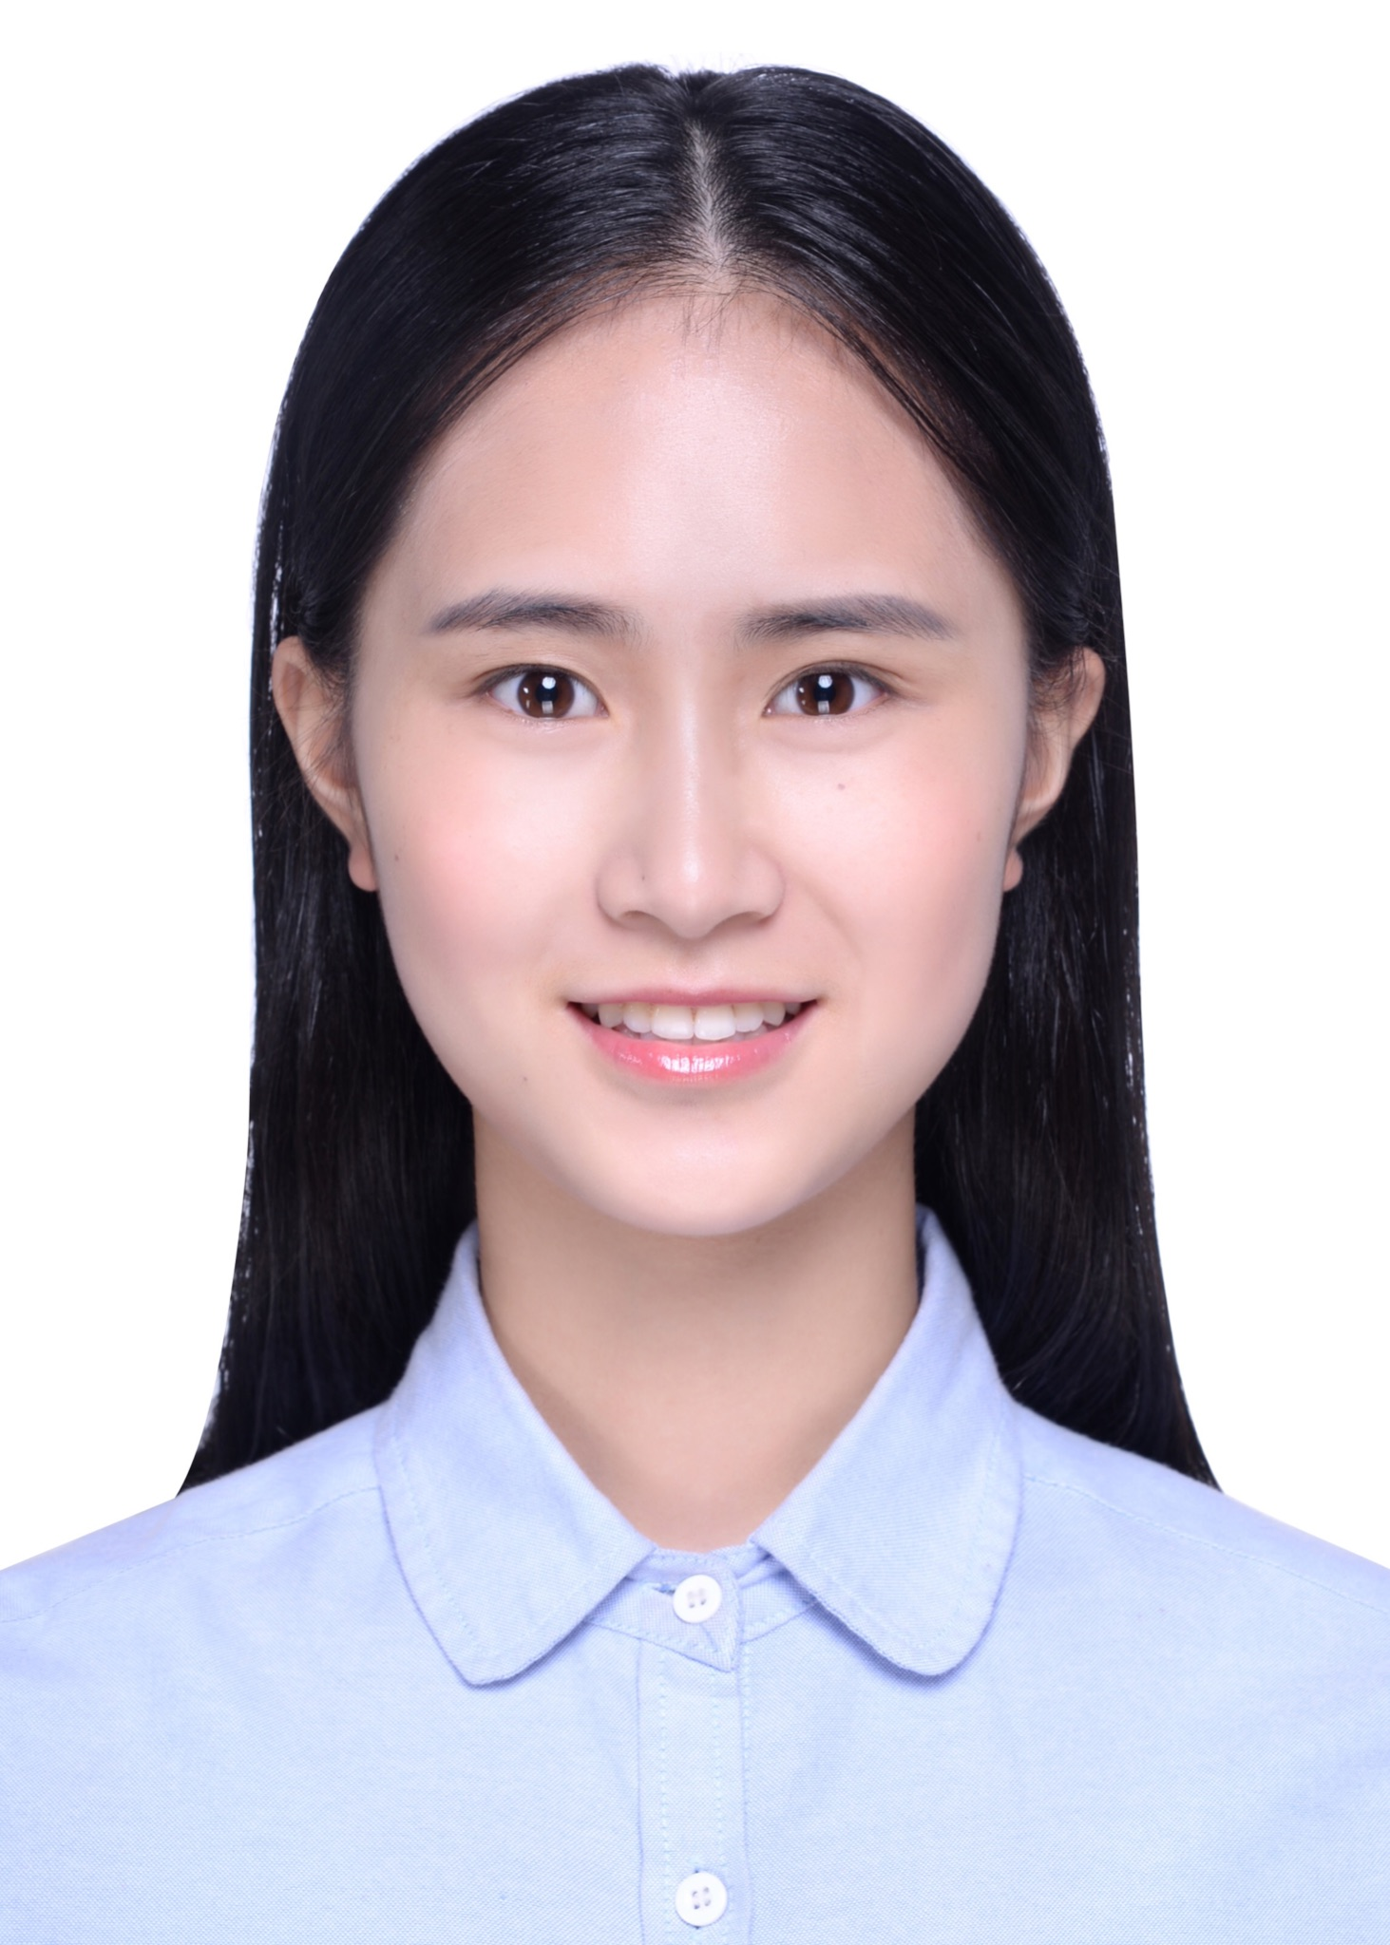

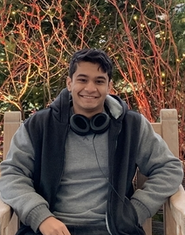
The Team
Manna (Xiangman) Zhao
Bhoomika Moorjani
Rosa (Zixuan) Jin
April (Yueni) Wang
Anirban Chowdhury

Slide 4
Our Understanding
Research question: “When two different data signals are supposedly getting at the same concept, do they agree?”
Our aim is to:
Identify and implement effective ways to determine if two signals are in agreement
If two signals disagree, investigate and provide insights into reasons for the disagreement

Slide 5
Our Approach
Exact numeric agreement
Spatial / temporal correlations
Rank correlation / Pearson correlation
Further research on effective methods
Statistical investigation on data segmented by region or time

Slide 6
Next steps
What specific signals or concepts should we focus on?
Should we be building a scoring method/evaluation model measuring the degree of agreement between signals (similar to the Forecast Evaluation Dashboard)?

Slide 7
Contacts
Bhoomika (main point of contact)
bmoorjan@cmu.edu
Ani
achowdh1@cmu.edu
April
yueniw@cmu.edu
Manna
xiangmaz@cmu.edu
Rosa
zixuanji@cmu.edu

Slide 8
Thank You

